Slide 1
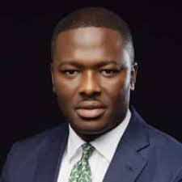
KOLA AINA
Born in Niger
Founded emerging platforms ltd tech company which focuses on enterprise software solutions.
Currently is a Google lauchpad accelerator mentor

Slide 2
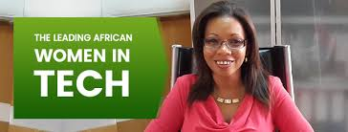
REBECCA ENONCHONG
Born in 1967 in Cameroon
Founder CEO of apps tech leading global provider of enterprise application solution.
She is the also the co-founder and board member of Cameroon angels network
She advocates for #BRINGBACK OURINTERNET

Slide 3
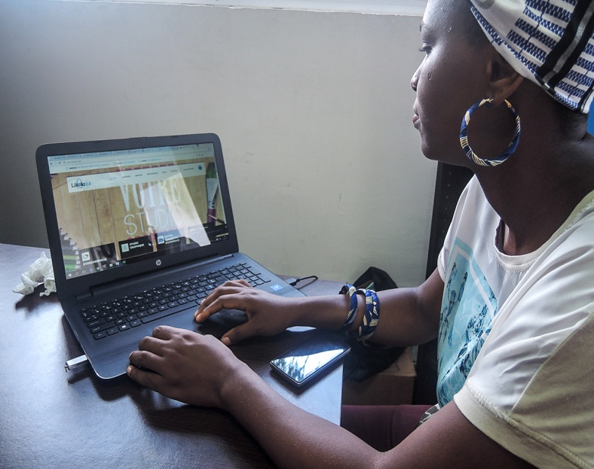
HORARE BEGBA
Born in Cameroon
Focuses on laptop screen in a small co-working space at the KMR startup hub in Dualo.
She started an organization ,Africa women startups also called African wits
Aim to train women to run their own technology

Slide 4
ABRAHAM OMANI
Born in Ghana .
Founder of online farmers farmart.
In 2017 he won pitch Agrihack Africa award by the technical centre for agriculture and rural co-operation

Slide 5
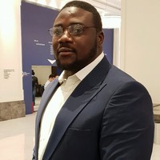
OLUFUNBI FALAYI
Co-founded and managed a few technology hubs including passion incubator.
His passionate about entrepreneurship information technology and social development

Slide 6
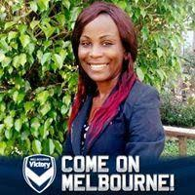
MIREILLE KOOH
Born in Cameroon.
The CEO of Afrik Tech Digital Marketplace
She founded the company in 2015 to educate professionals from Africa on technology innovation and entrepreneurship.

Slide 7
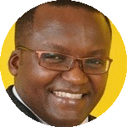
MOSES KEMIBARO
16 years’ experience in digital marketing strategy, creative design, business apps, technology integration, digital marketing, social media and mobile (web, marketing & apps).
Tec blogger and worked at Africa Online, 3mice, Kenya web, and OLX Kenya (Naspers).

Slide 8
RIAZ MOOLA
Founder of Hyperion development.
Won the first Africa innovation challenge world as the leading ed -Tech

Slide 9
JAUN PIENNAR
Founder of apex media.
Co-operate video, creates apps

Slide 10
BABDELLEH MALLEK
Co –founder of sylabs.
Co-founder of tech hub in algeria

